Slide 1
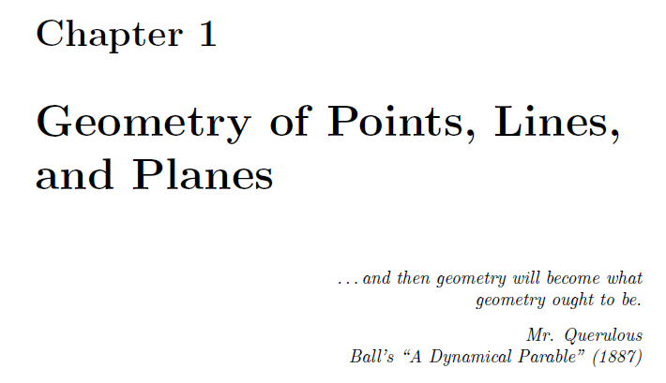

Slide 2
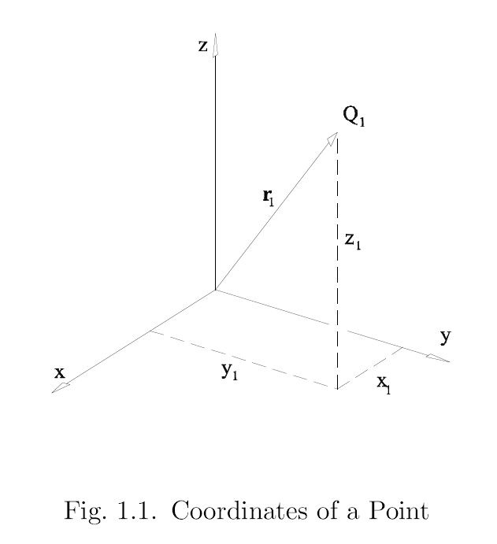

Slide 3
A point, r, is defined by the parameters w and S_{O} where
The coordinates of a point are (w ; S_{O}).
S_{O} = x i + y j + z k where x, y, and z have units of length. w is dimensionless.
Thus the coordinates of a point can be written as (w ; x, y, z).
Point coordinates are homogeneous, i.e. multiplying the coordinates by a scalar λ defines the same point.
The coordinates of points at infinity will have w=0.
equation of a point
coordinates of a point

Slide 4
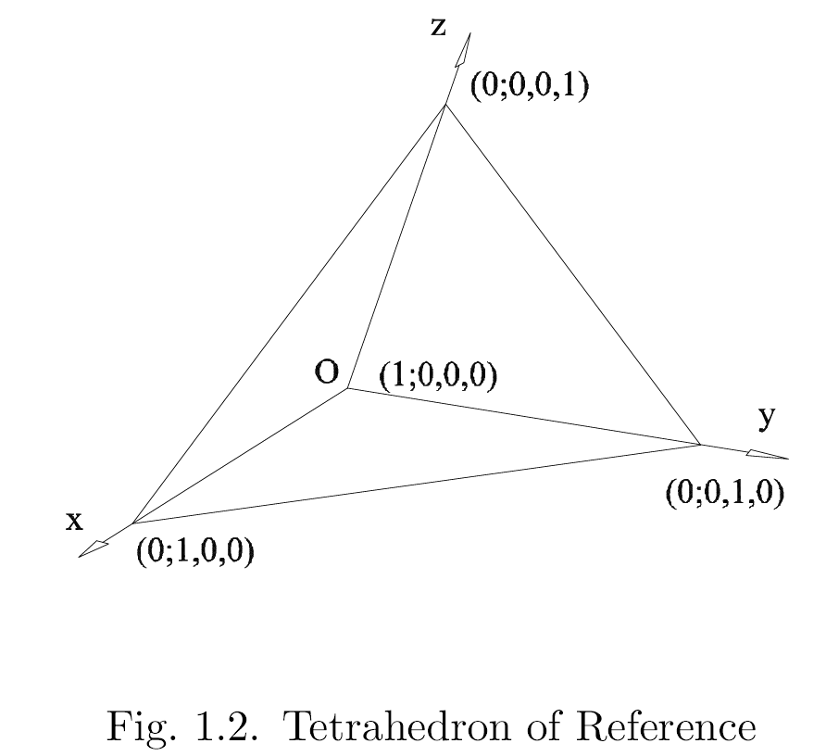

Slide 5
 | homogeneous coordinates | equation | misc
point | (w ; x, y, z) ( . ; L, L, L) | r w = S_{O} where S_{O} = xi + yj + zk | ∞³ points in 3D space

Slide 6
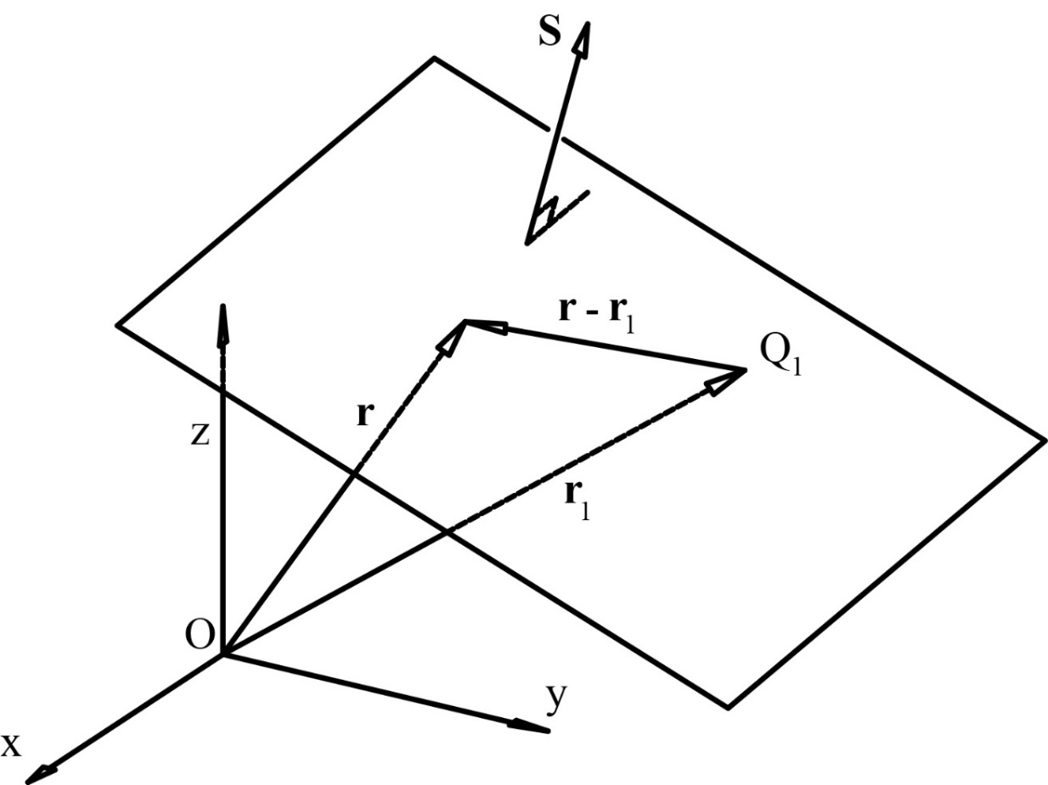
How to define a plane?
suppose we are given S and r₁ where:
r₁ is a vector to some point on the plane (units of L)
S is the direction vector ⊥ to the plane (dimensionless)
let r be a vector to any arbitrary point on the plane
Can we come up with some general expression
for r in terms of S and r₁?

Slide 7
(r – r₁) ⋅ S = 0
will write as
r ⋅ S + D_{O} = 0
where D_{O} = -r₁ ⋅ S
equation of the plane
units of length
coordinates of the plane: [D_{O} ; A, B, C]
where S = Ai + Bj + Ck
what does it mean when D_{O} = 0 ?
these are homogeneous coordinates

Slide 8
Determine the coordinates of a plane, i.e. [D_{O} ; A, B, C] when given 3 points on the plane.
sample problem 1.3.2 (i)
P (1 ; 3, 4, 1) ( . ; m, m, m)
Q (1 ; -1, 2, 4)
R (1 ; 3, 2, 2)

Slide 9
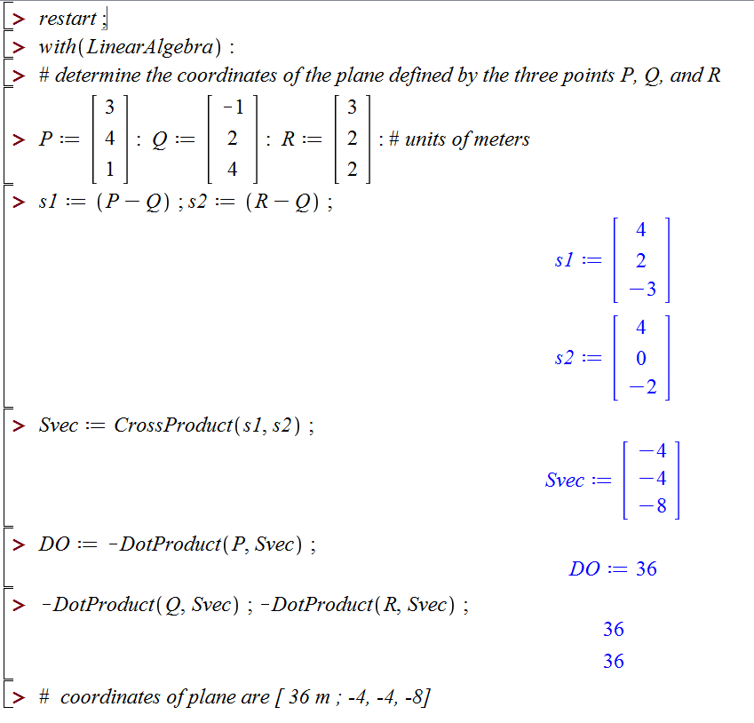
The vectors s₁ and s₂ are in the plane.

Slide 10
Given the coordinates of a plane, i.e. [D_{O} ; A, B, C]:
can I calculate a point on the plane?
can I find the point on the plane that is closest to the origin?

Slide 11
given: [3.2 ; 1, 3, 2] [ m ; . , . , . ], find: a point on the plane

Slide 12
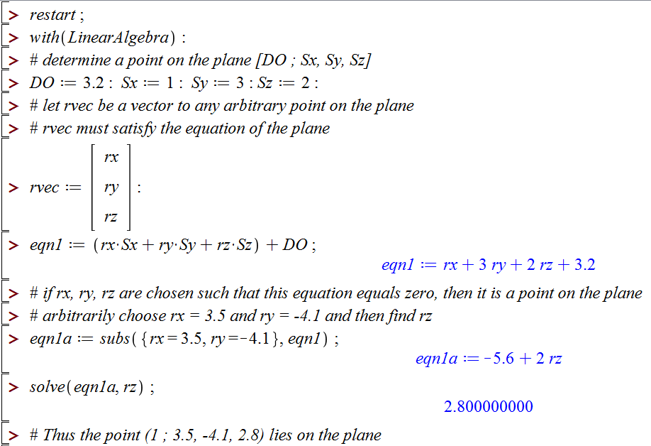
given: [3.2 ; 1, 3, 2] [ m ; . , . , . ], find: a point on the plane

Slide 13
Given the coordinates of a plane, i.e. [D_{O} ; A, B, C]:
can I calculate a point on the plane?
can I find the point on the plane that is closest to the origin?

Slide 14

p

Slide 15
New problem:
given: e, f, g, h (three vectors and a scalar)
(1)
(2)
find: a
Cross both sides of (1) with g.
h

Slide 16
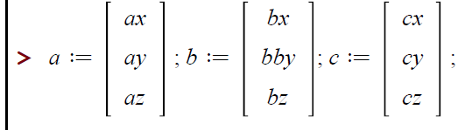
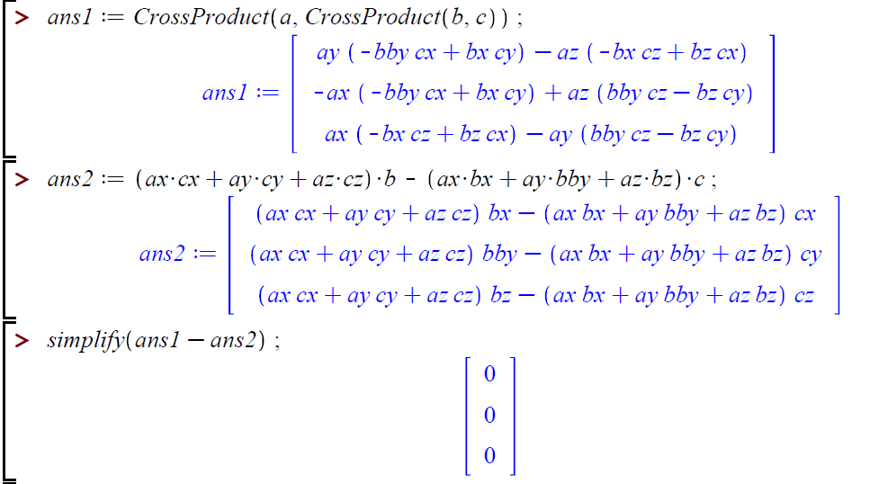

Slide 17
p

Slide 18
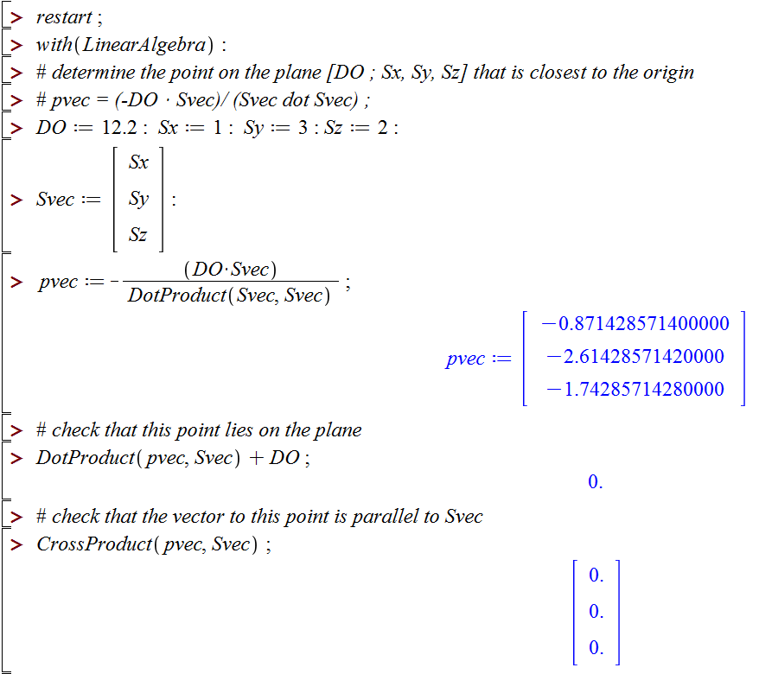
given: [12.2 ; 1, 3, 2] [ m ; . , . , . ], find: the point on the plane closest to the origin

Slide 19
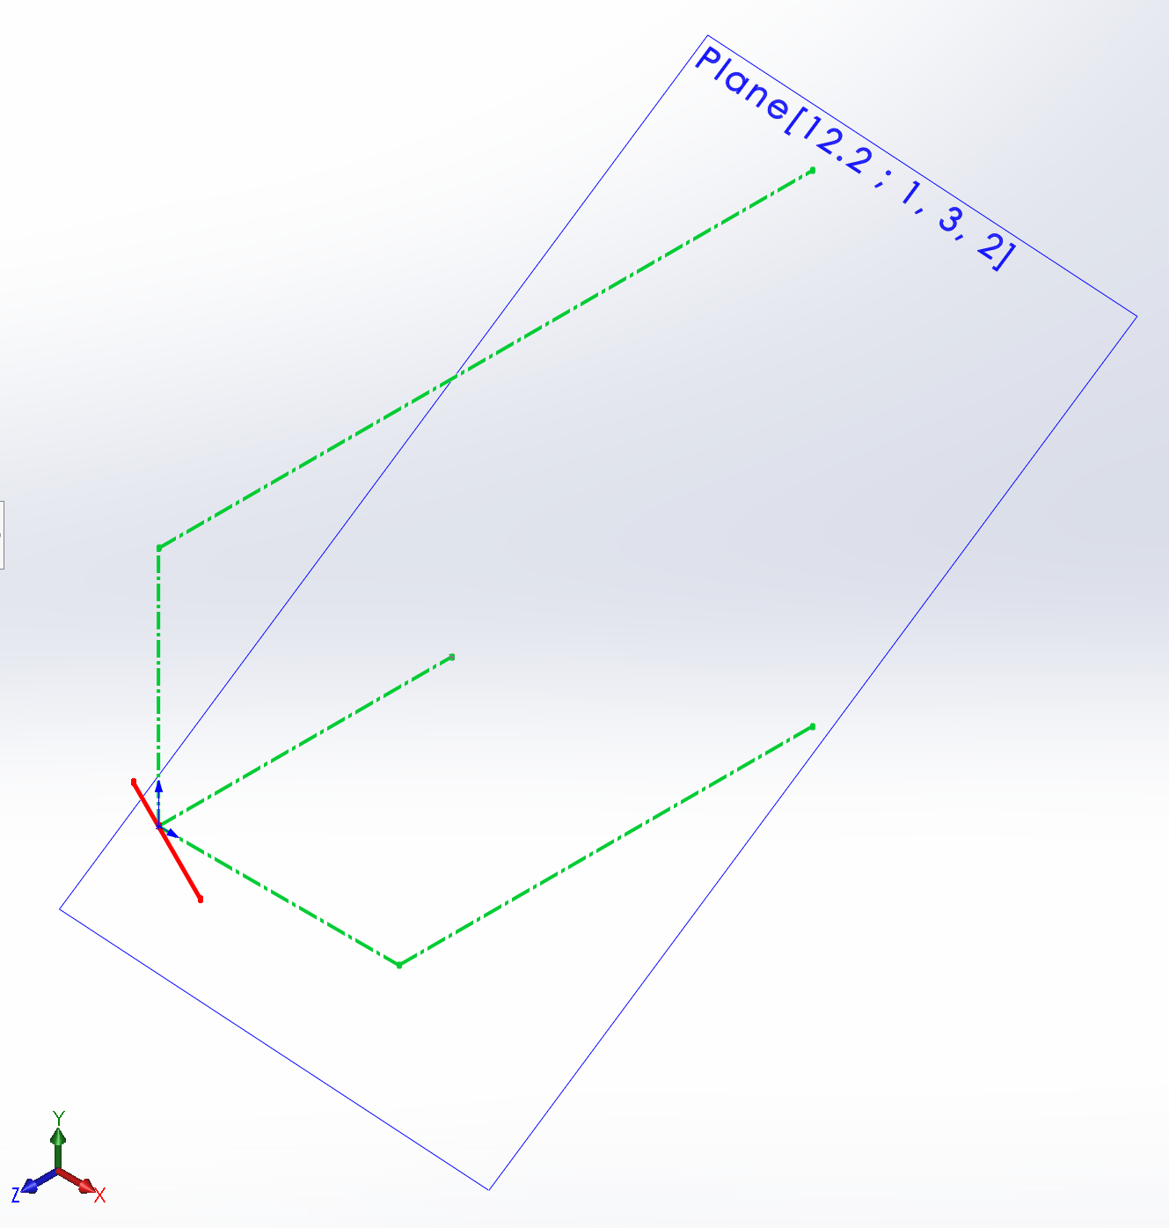
given: [12.2 ; 1, 3, 2] [ m ; . , . , . ], find: the point on the plane closest to the origin
(1 ; 0, 5, -13.6)
(1 ; 0, 0, -6.1)
(1 ; 5, 0, -8.6)
(1 ; -0.8714, -2.6143, -1.7429)

Slide 20
 | homogeneous coordinates | equation | misc
point | (w ; x, y, z) ( . ; L, L, L) | r w = S_{O} where S_{O} = xi + yj + zk | ∞³ points in 3D space
plane | [D_{O} ; A, B, C] [ L ; . , . , . ] | r ⋅ S + D_{O} = 0 where S = Ai + Bj + Ck | ∞³ planes in 3D space

Slide 21
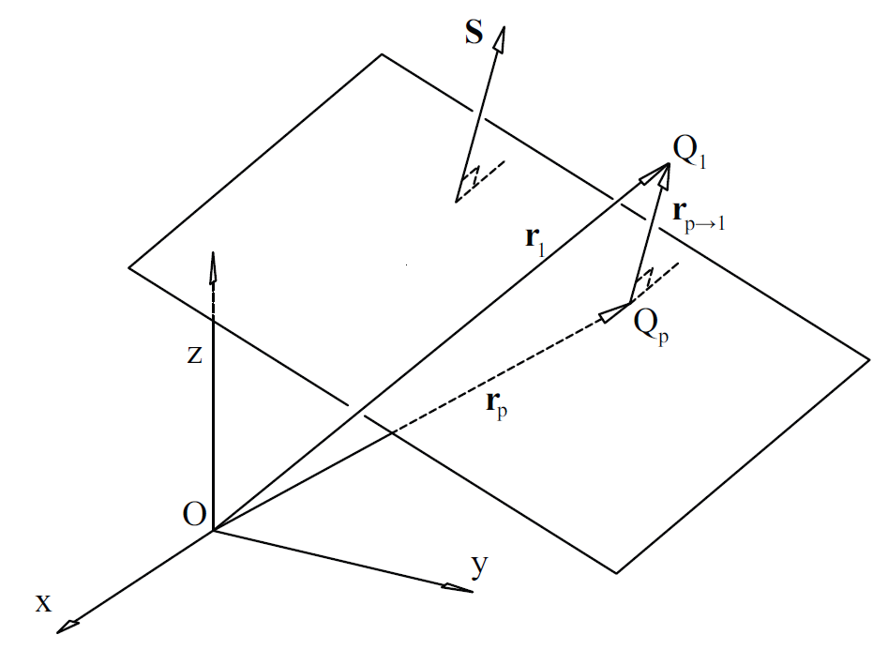
given: [D_{O} ; S ] , r₁
find: r_{p}, the point on the plane that is closest to Q₁

Slide 23
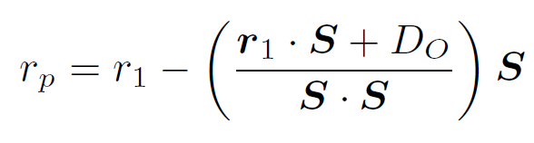
given: [D_{O} ; S ] , r₁
find: r_{p}, the point on the plane that is closest to Q₁

Slide 24
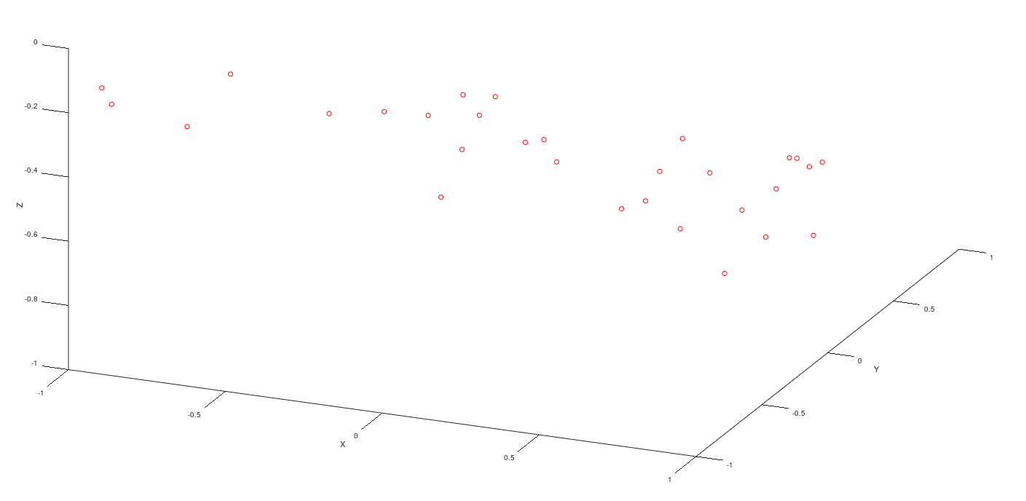
Given: coordinates of n points
Find: the ‘best fit’ plane

Slide 25
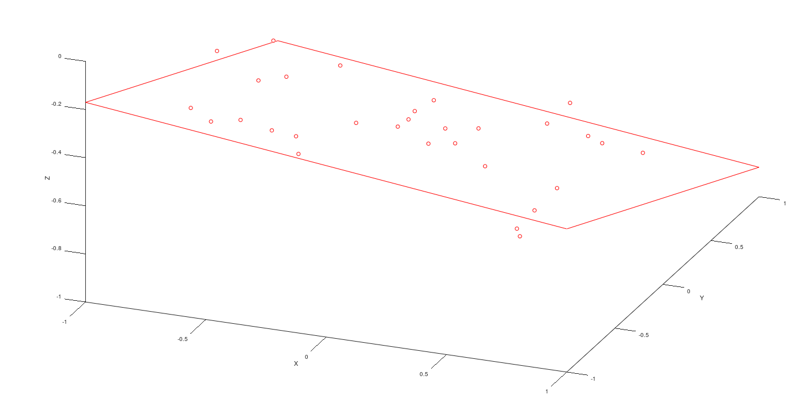
Given: coordinates of n points
Find: the ‘best fit’ plane
need to find ‘best’ values for [D_{O} ; S]
minimize the sum of the squares of the distances from the points to the ‘best fit’ plane

Slide 26
Given: coordinates of n points
Find: the ‘best fit’ plane
we would like all the points to satisfy
since the plane coordinates are homogeneous, let D_{O} = 1
we have i equations in 3 unknowns

Slide 27
Given: coordinates of n points
Find: the ‘best fit’ plane
we would like all the points to satisfy
since the plane coordinates are homogeneous, let D_{O} = 1
_{residuals}
_{optimal choice for x}

Slide 28
In general, we won’t be able to find values for S_{X}, S_{y}, and S_{z} that will exactly satisfy all i equations. There will be residual values for each equation for any guess of x.
Will try to find the optimal solution for x, x_{opt}, such that the sum of the squares of the residuals will be as small as possible.

Slide 29
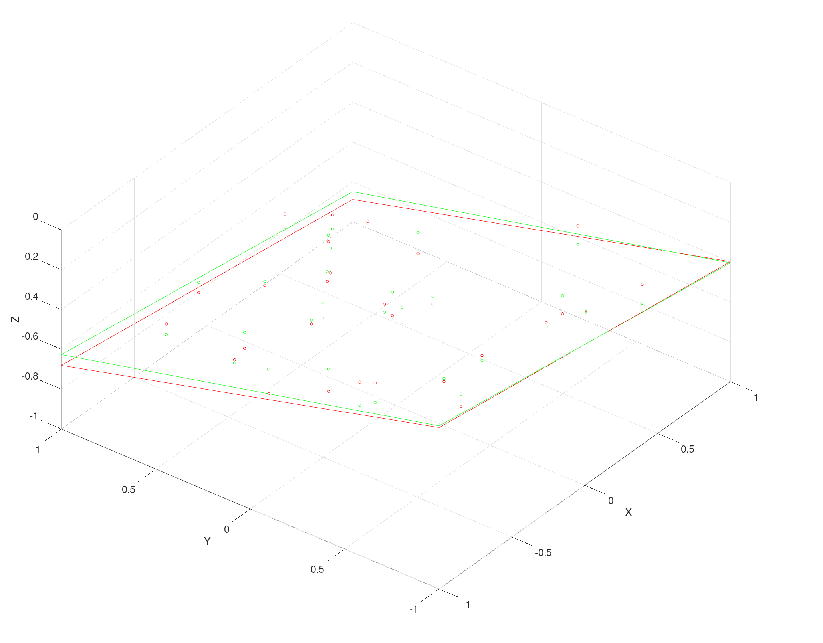
The sum of the squares of the residuals
can be written as
The minimum value of e^{T} e can be found by determining the values for S_{x}, S_{y}, and S_{z} such that the three partial derivatives
will all equal zero.

Slide 30
Now recall that
and e_{i} is given by

Slide 31
similarly

Slide 32
The three partial derivatives will all equal zero when
These three equations can be written in matrix form as
Now substitute to get
Rearrange to get
Now solve for x_{opt} as

Slide 33
suppose we have 22 points
the matrix A is 22×3
the vector b is 22×1
A^{T} is 3×22
A^{T} A is 3×3
A^{T} b is 3×1
and finally, x_{opt} is 3×1

Slide 34
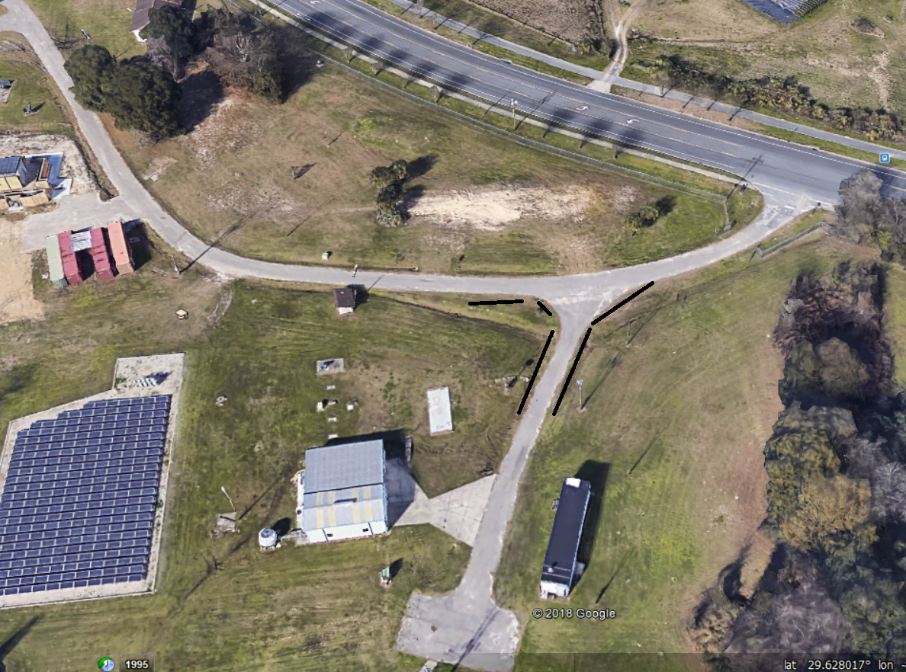
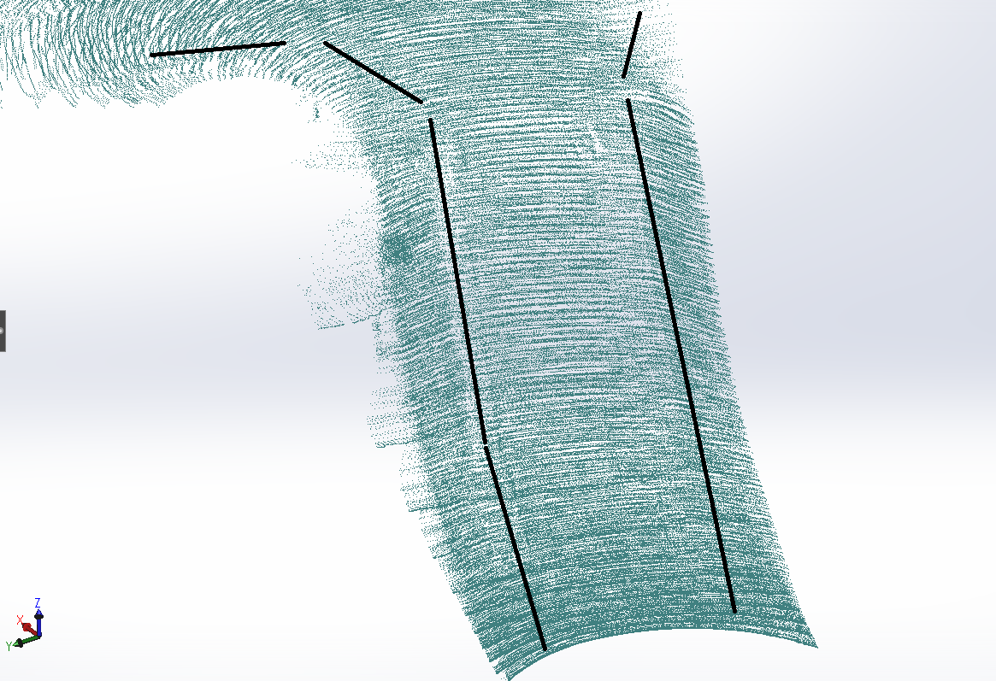
719,849 points

Slide 35
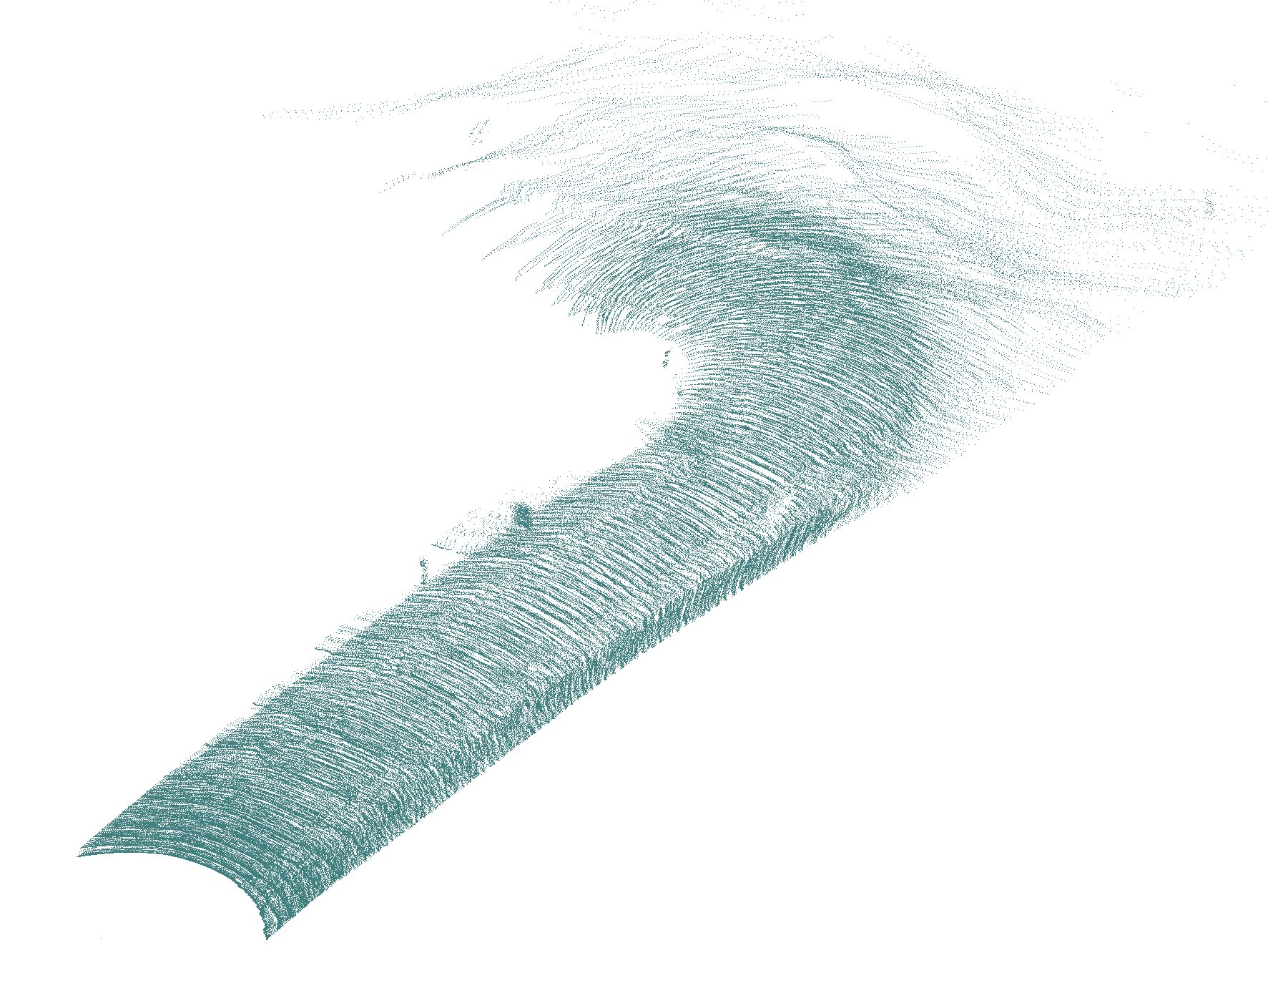

Slide 36


Slide 37
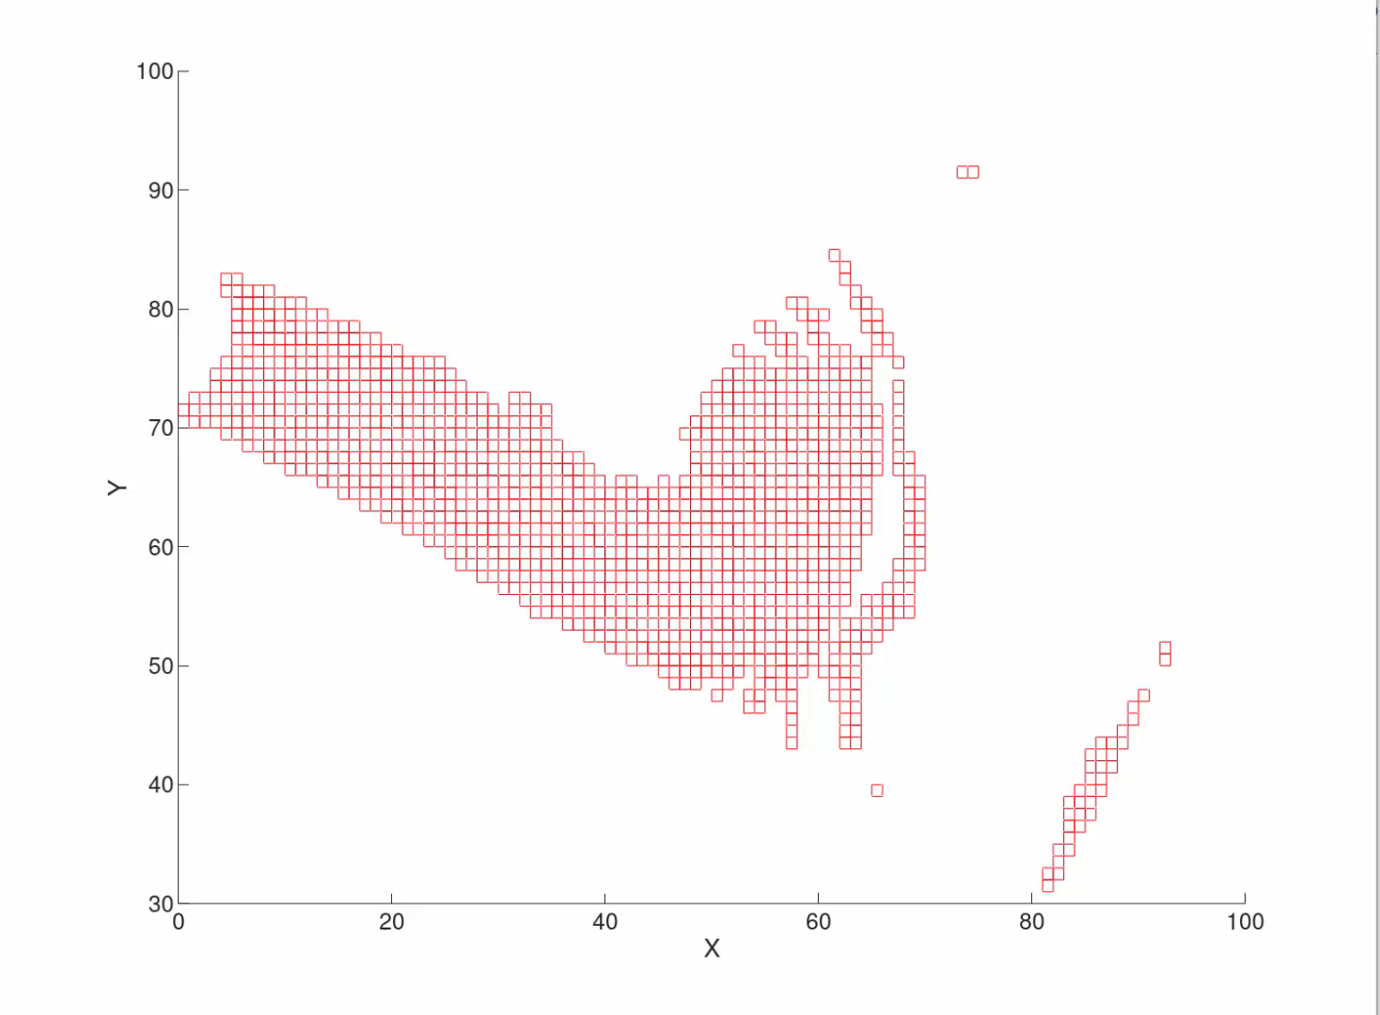
cells with 30 or more points in them

Slide 38
Problem: What if the ‘best fit plane’ passes through the origin? Then D_{O} should be 0, but we set it equal to 1.

Slide 39
 | homogeneous coordinates | equation | misc
point | (w ; x, y, z) ( . ; L, L, L) | r w = S_{O} where S_{O} = xi + yj + zk | ∞³ points in 3D space
plane | [D_{O} ; A, B, C] [ L ; . , . , . ] | r ⋅ S + D_{O} = 0 where S = Ai + Bj + Ck | ∞³ planes in 3D space

Slide 40
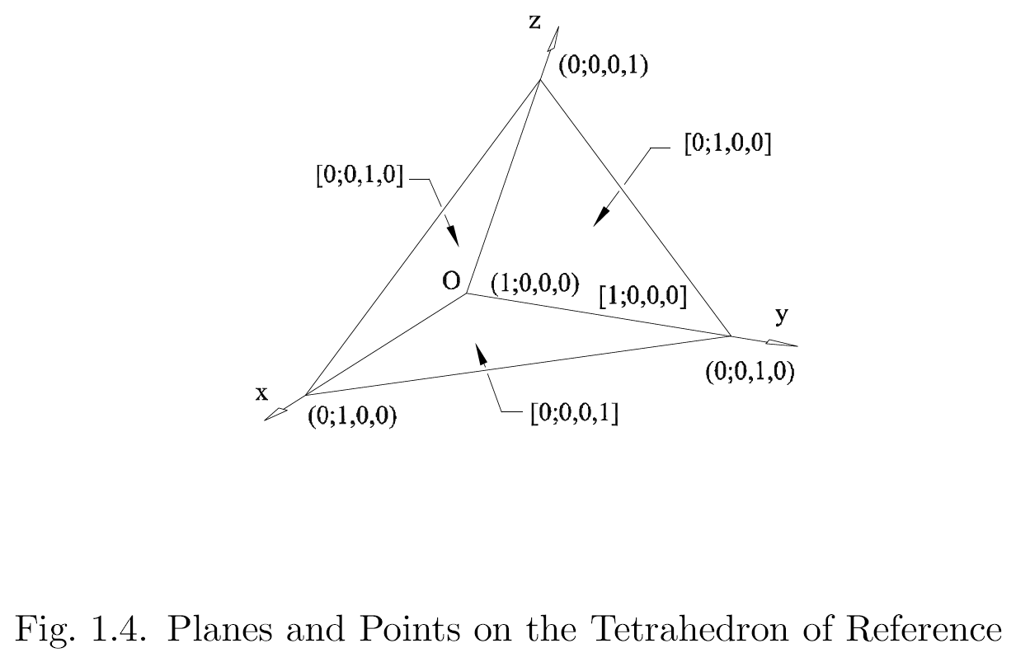

Slide 41
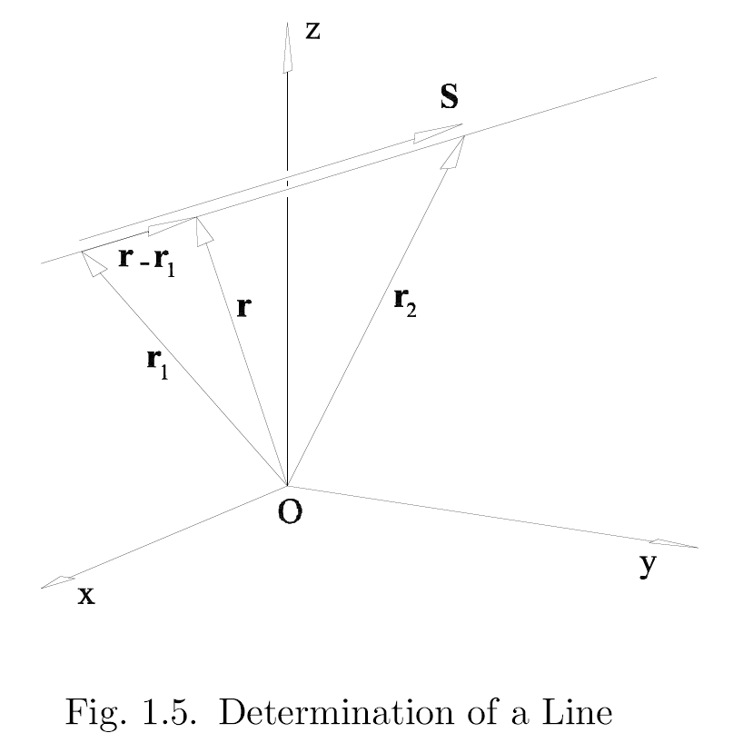
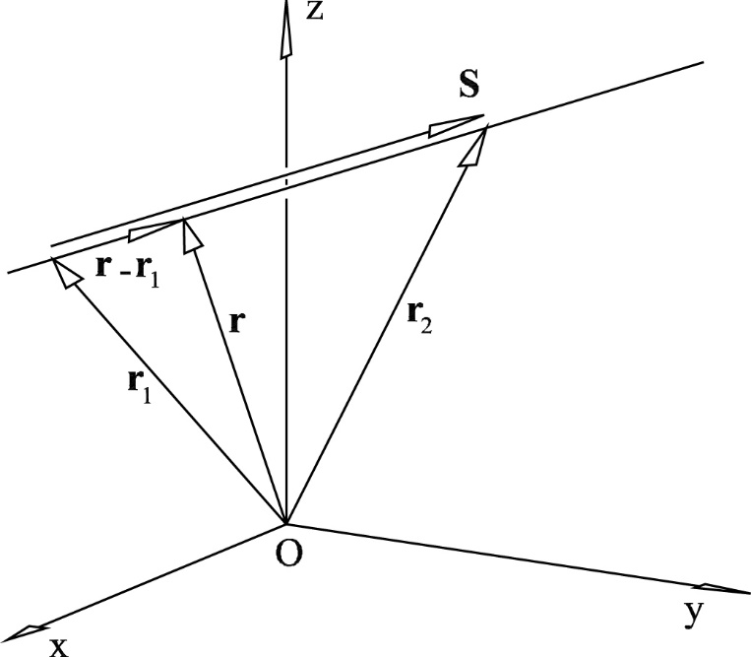
a line can be defined by two points, r₁ and r₂
S = r₂ – r₁ (dimensionless direction vector)
(r –r₁) × S = 0
r × S = r₁ × S
let S_{OL} = r₁ × S (units of length)
then
r × S = S_{OL} is the equation of the line
where
{S ; S_{OL}} are the Plücker coordinates of the line
Note that S · S_{OL} = 0

Slide 42
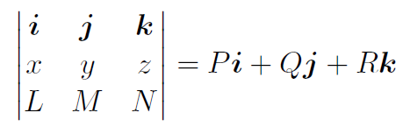
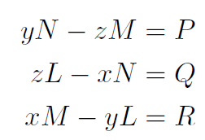
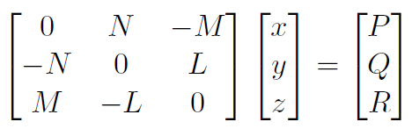
given: S = Li + Mj + Nk , S_{OL} = Pi + Qj + Rk
find: a point on the line
r × S = S_{OL}

Slide 43
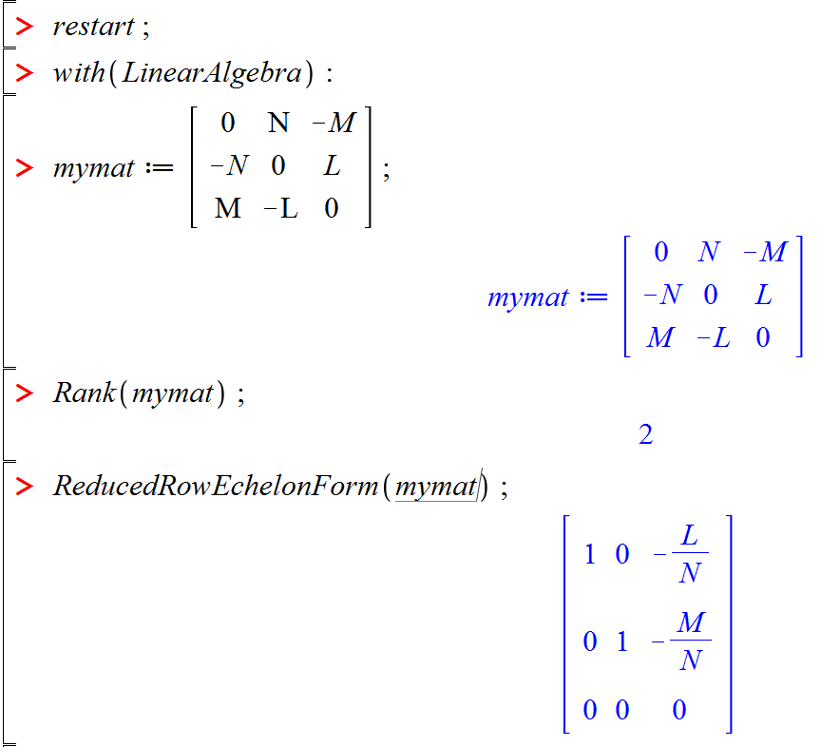

Slide 44
given: {4, 3, 1 ; 2, -2, -2}, find: a point on the line
dimensionless
meters

Slide 45
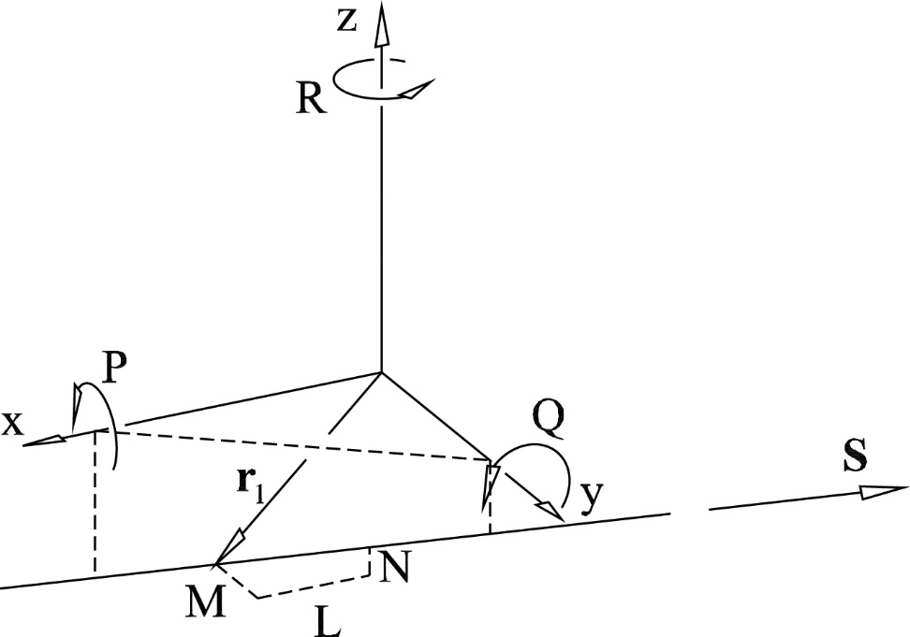
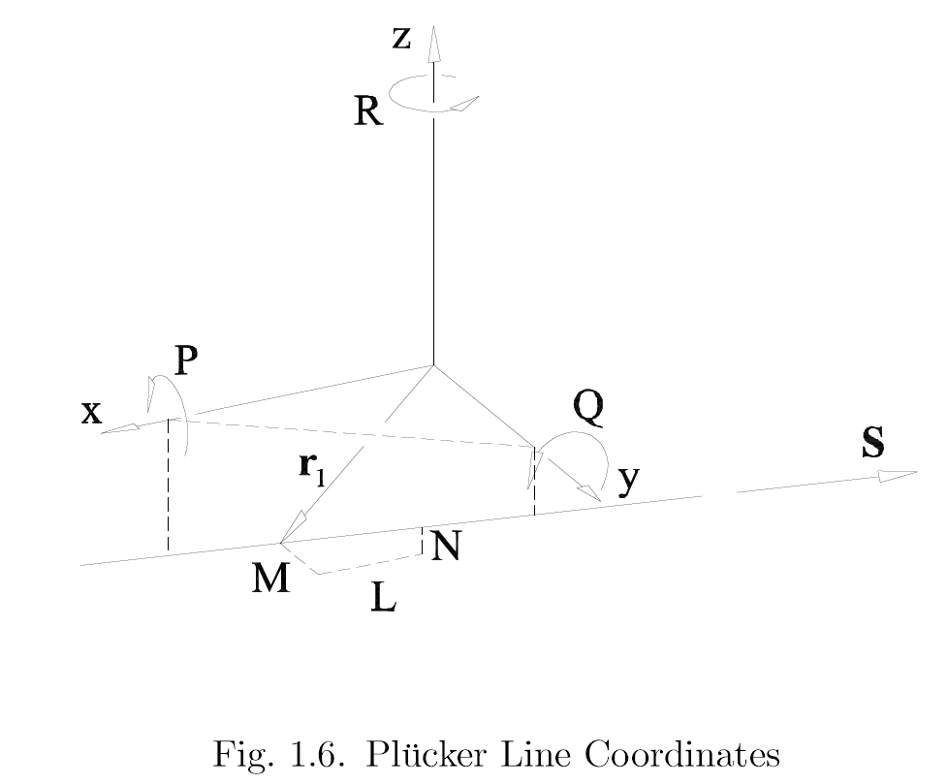
{S ; S_{OL}}
{L, M, N ; P, Q, R}
1.7

Slide 46
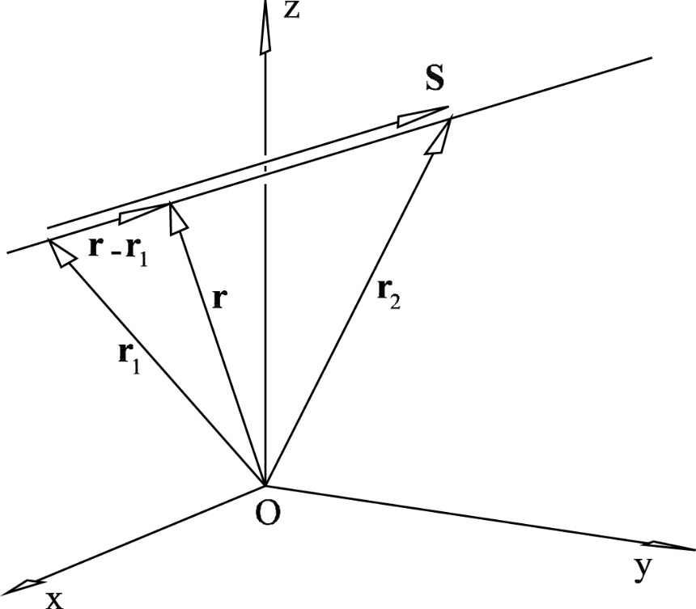
Given the coordinates of a line, i.e. {S ; S_{OL}}:
can I find the point on the line that is closest to the origin?
1.6

Slide 48
Given the coordinates of a line, i.e. {S ; S_{OL}}:
can I find the point on the line that is closest to the origin?
1.6

Slide 49
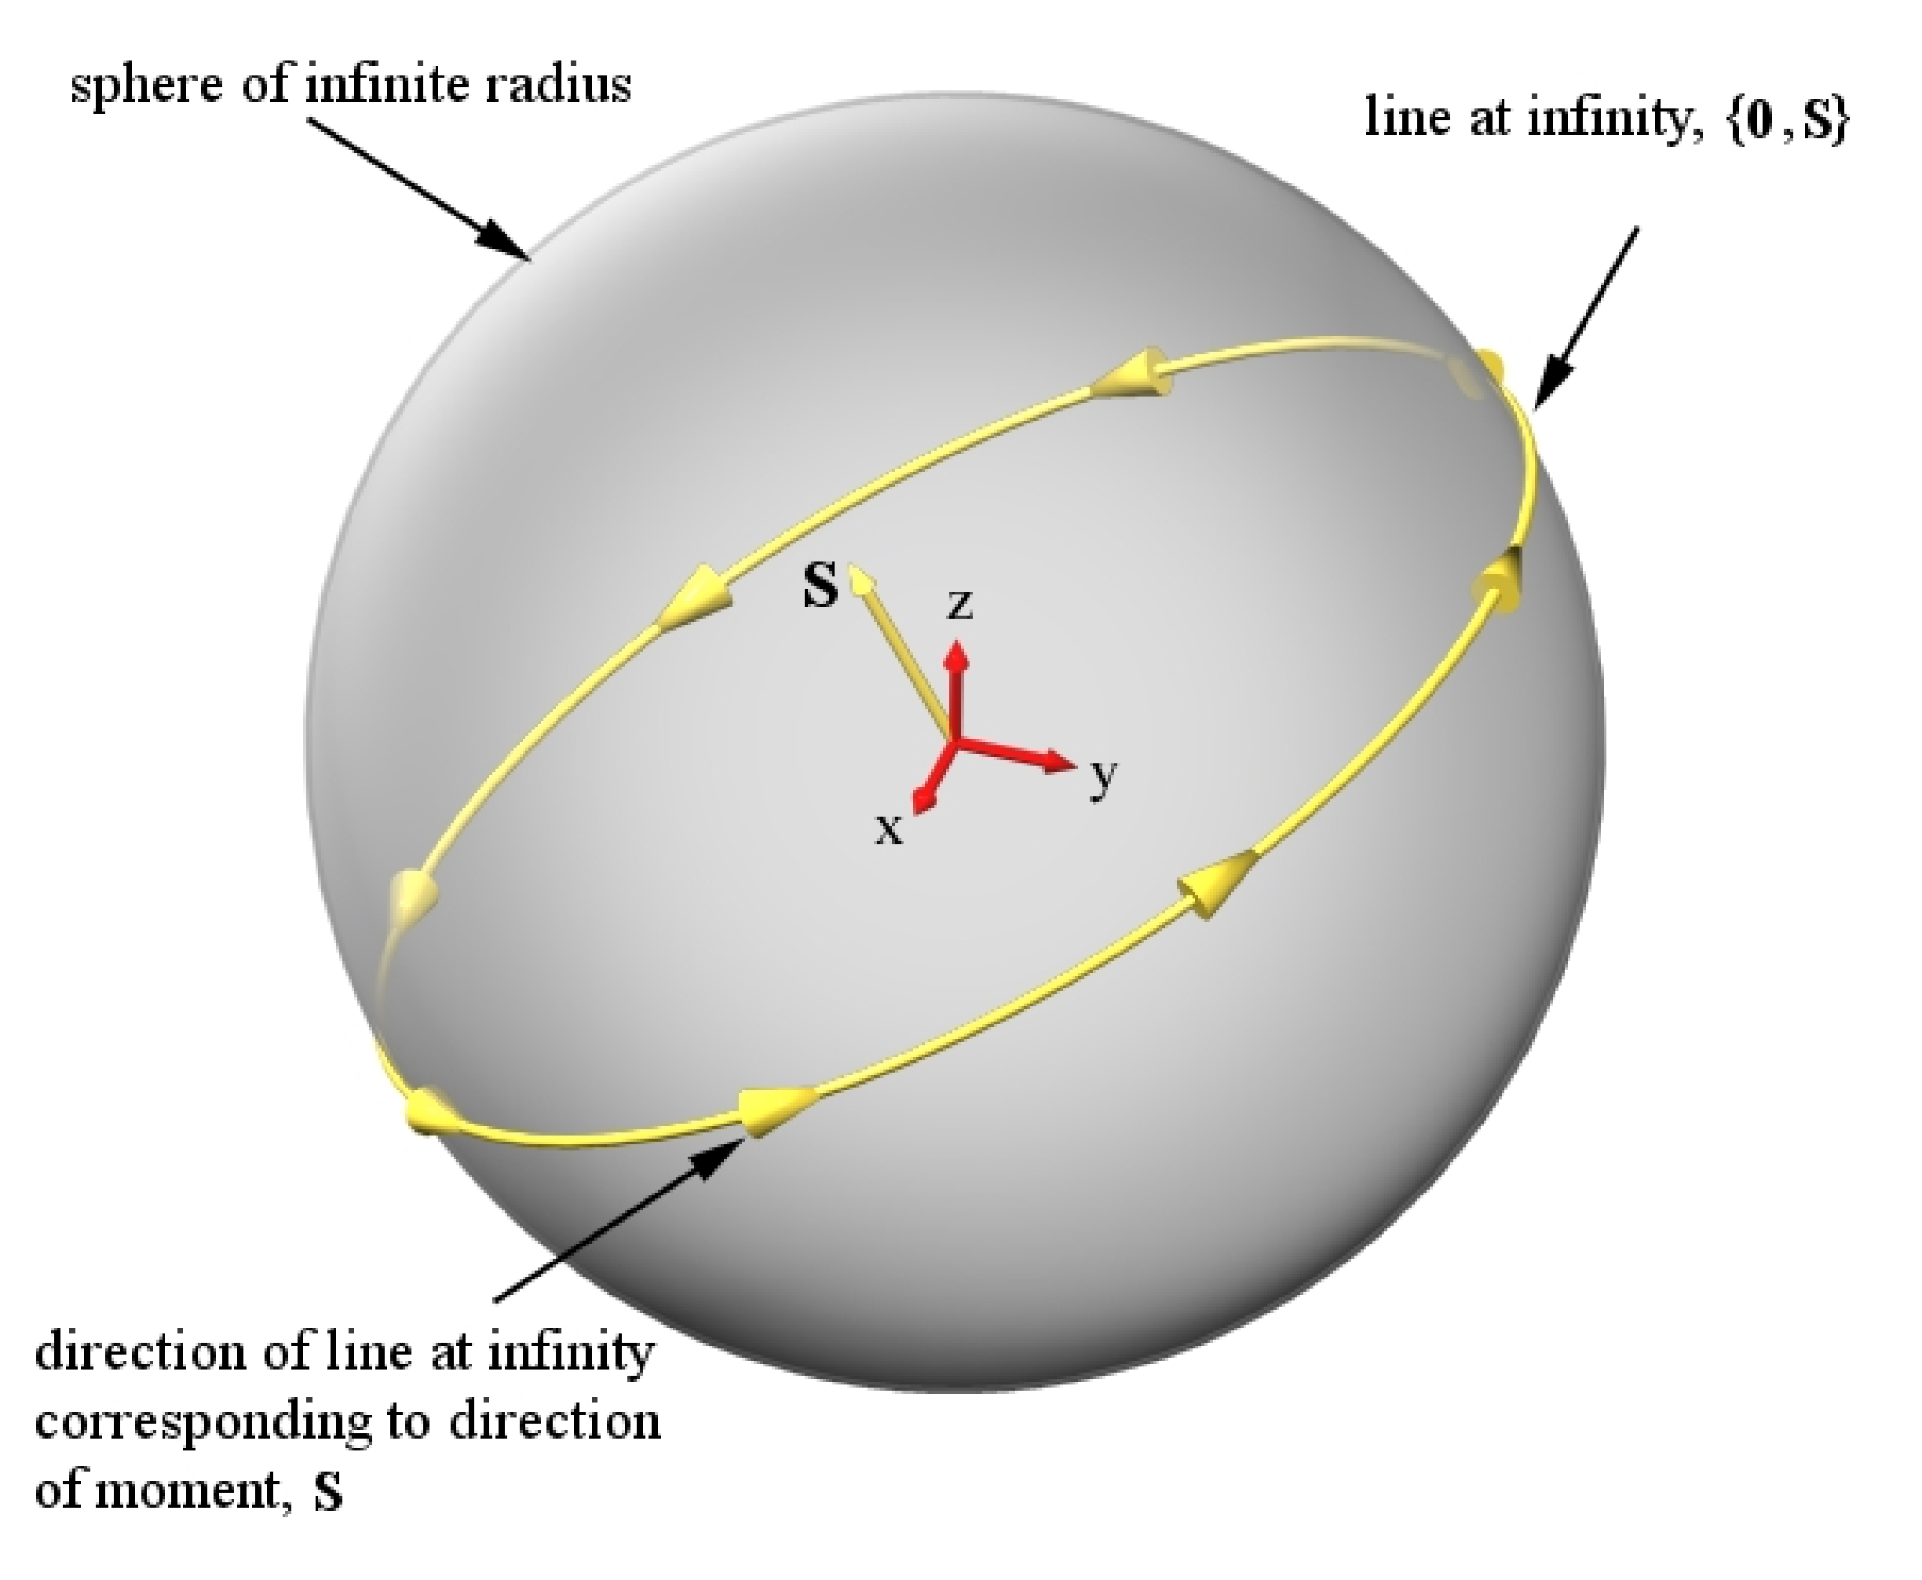
Figure 1.8: Conceptualization of the Line at Infinity, {0 ; S}

Slide 50
Example problem 1.5.1
Determine the Plucker coordinates of the line that passes through the points r₁ = 3i + 5j – 6k and r₂ = 6i – 5j +2k (units of meters).
Determine the perpendicular distance of this line from the origin.
Determine the coordinates of another point on the line.

Slide 51
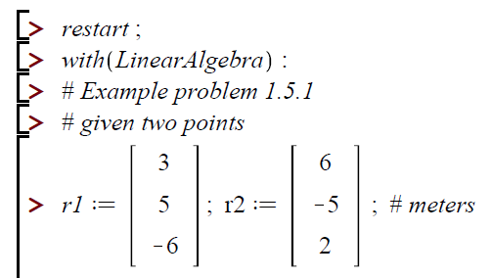
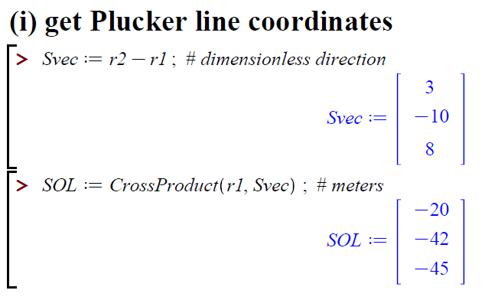

Slide 52
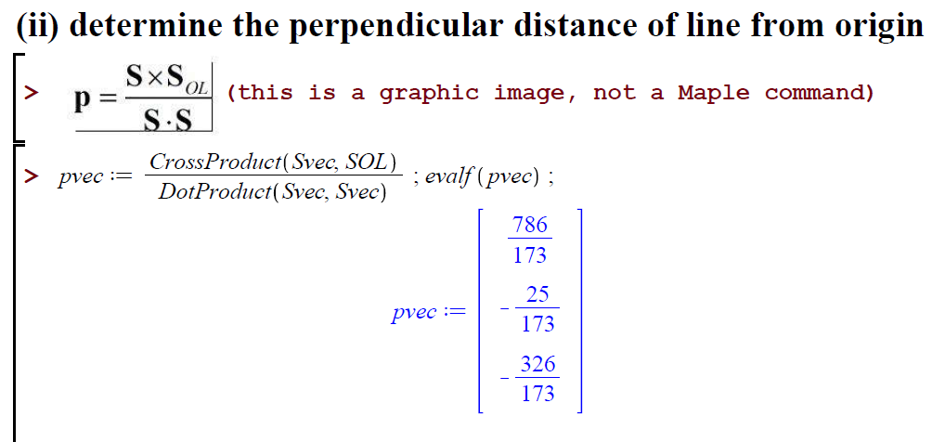
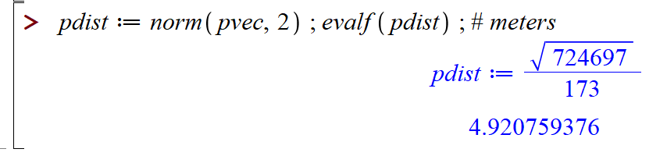

Slide 53
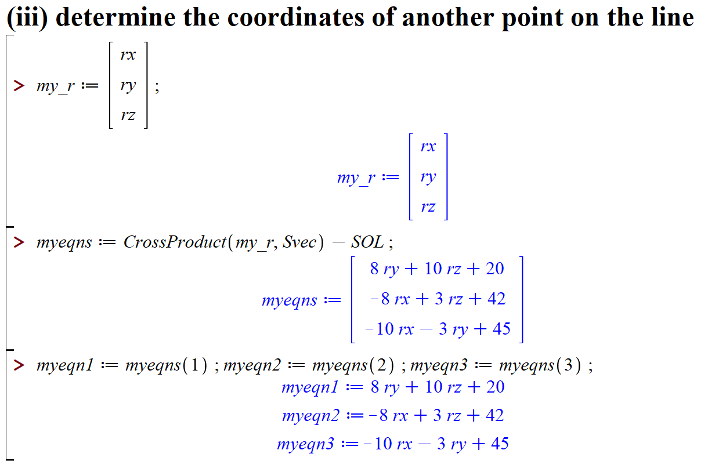
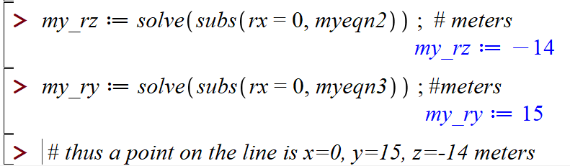

Slide 54
 | homogeneous coordinates | equation | misc
point | (w ; x, y, z) ( . ; L, L, L) | r w = S_{O} where S_{O} = xi + yj + zk | ∞³ points in 3D space
plane | [D₀ ; A, B, C] [ L ; . , . , . ] | r ⋅ S + D_{O} = 0 where S = Ai + Bj + Ck | ∞³ planes in 3D space
line | {S ; S_{OL}} ( . , . , . ; L, L, L) where S ⋅ S_{OL} = 0 | r × S = S_{OL} | ∞⁴ lines in 3D space

Slide 55
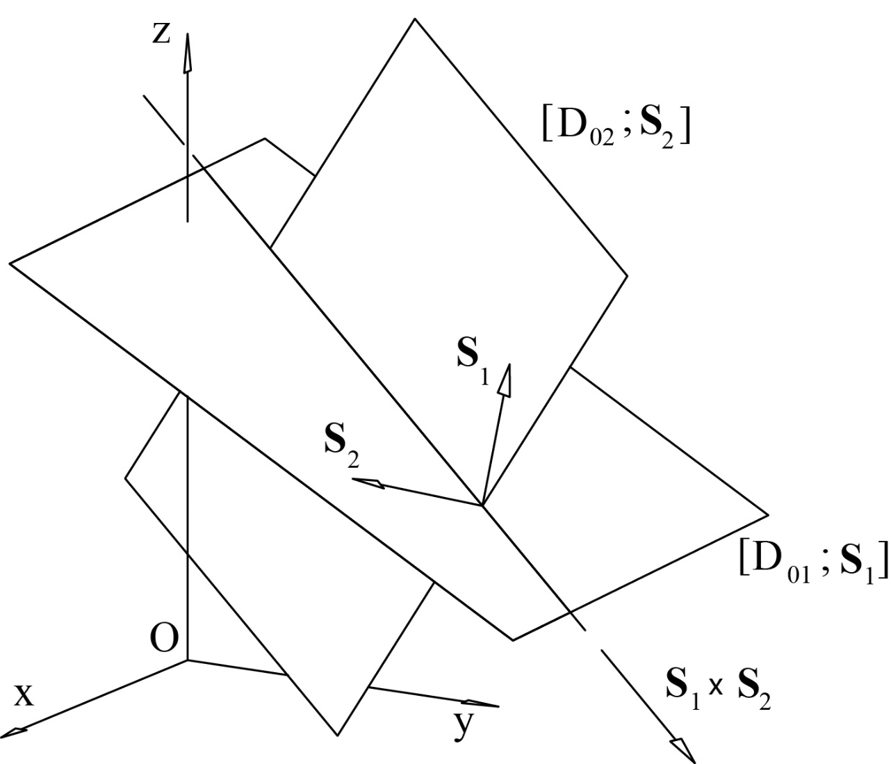
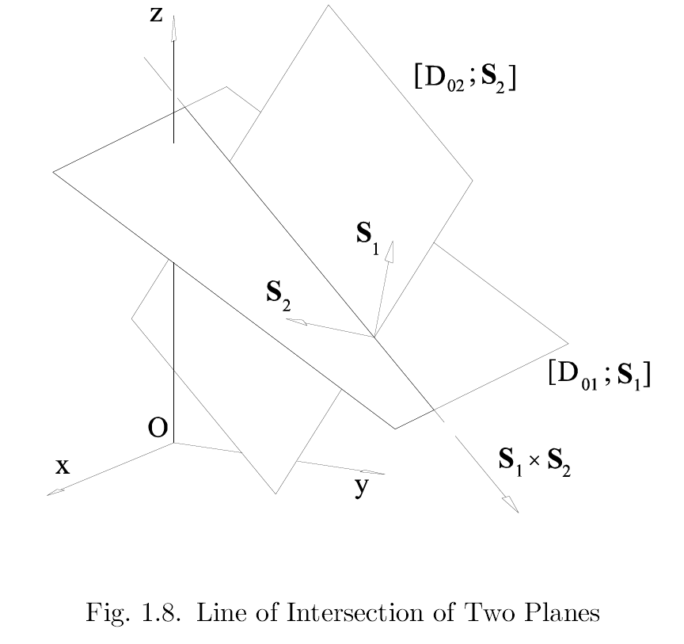
1.6 Two planes determine a line.
1.9

Slide 56

1.6 Two planes determine a line.
given: [D_{O1} ; S₁], [D_{O2}, S₂]
find: coord. of line of intersection {S₃ ; S_{OL3}}
It is apparent that
S₃ = S₁ × S₂
Let’s write
r × (S₁ × S₂) where r is any point on the line
r × (S₁ × S₂) = (r ⋅ S₂) S₁ - (r ⋅ S₁) S₂
= (-D_{O2}) S₁ - (-D_{O1}) S₂
Is this a line? Does S₃ ⋅ S_{OL3}= 0 ?
S₃
S_{OL3}

Slide 57
Ray and axis coordinates:
duality

Slide 58
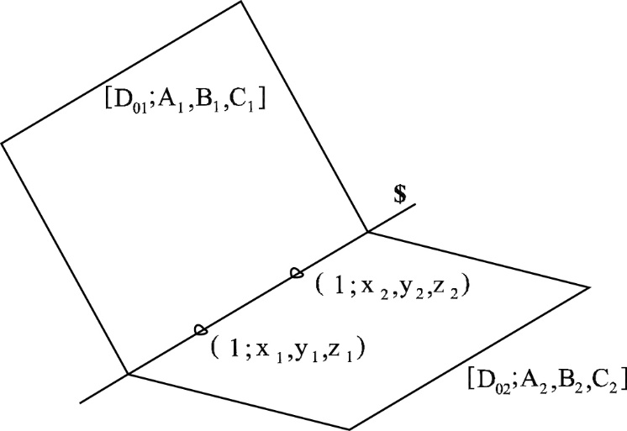
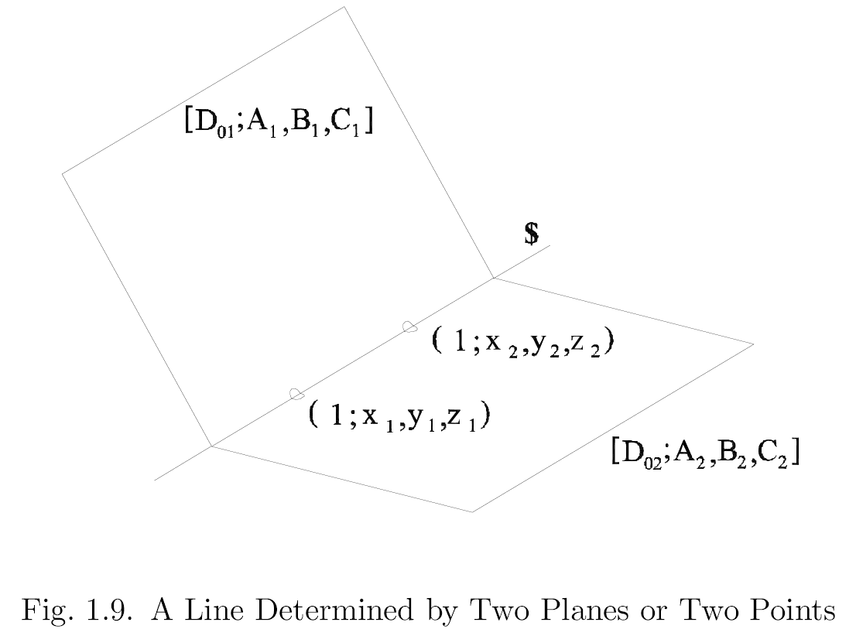
1.10

Slide 59
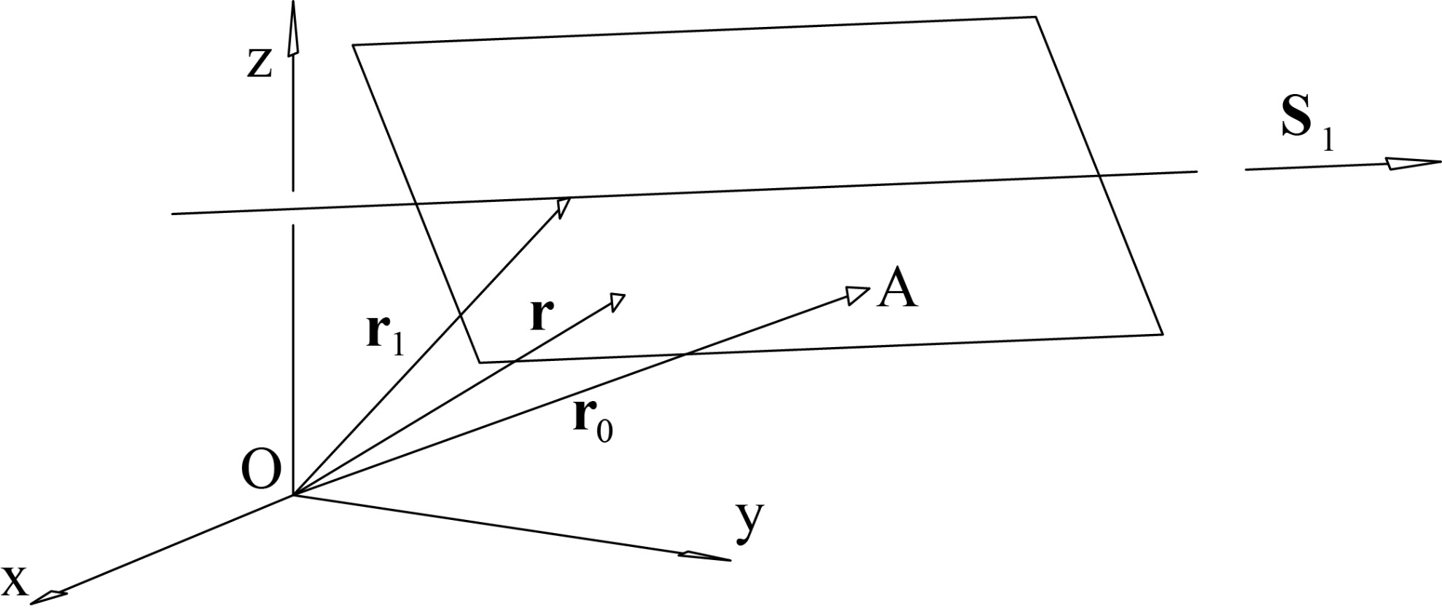
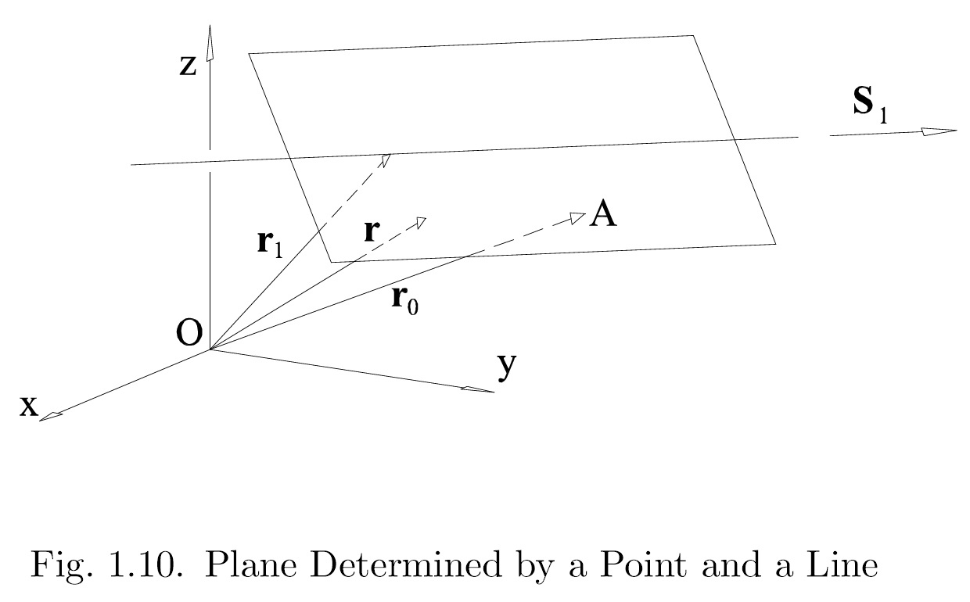
1.7.1 The plane defined by a line and a point.
1.11

Slide 60

1.7.1 The plane defined by a line and a point.
given: line defined by S₁ and a point r₁ ;
point r₀
find: coord. of plane [D_{O3} ; S₃]

Slide 61
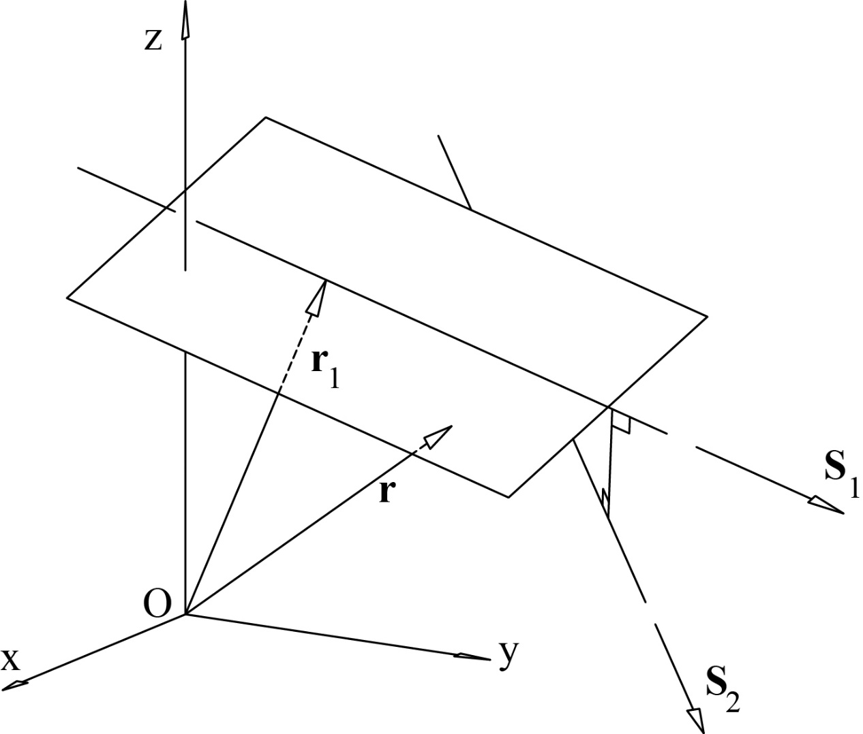
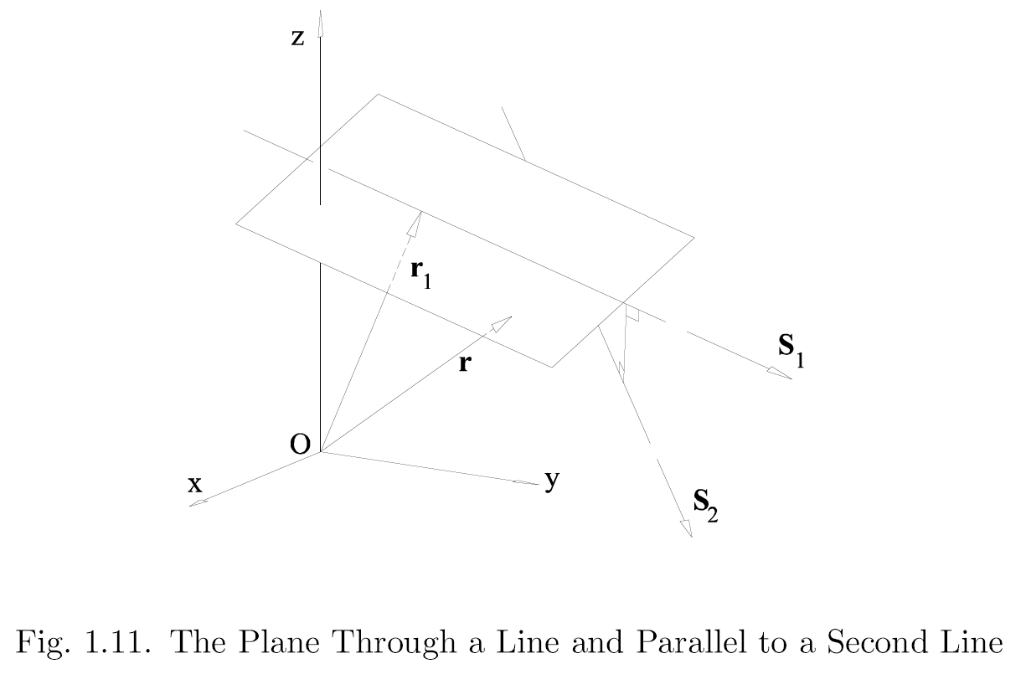
1.7.2 The plane which contains a line and is parallel to a second line.
1.12

Slide 62
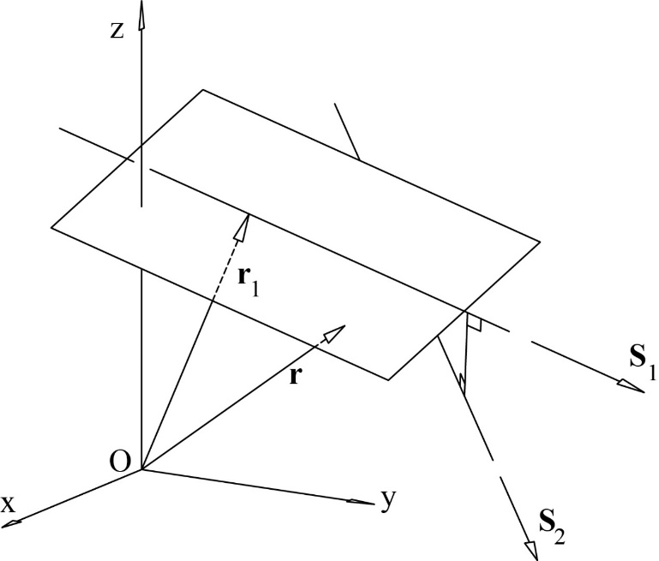
1.7.2 The plane which contains a line and is parallel to a second line.
given: line defined by S₁ and a point r₁ ;
direction S₂
find: coord. of plane [D_{O3} ; S₃]

Slide 63
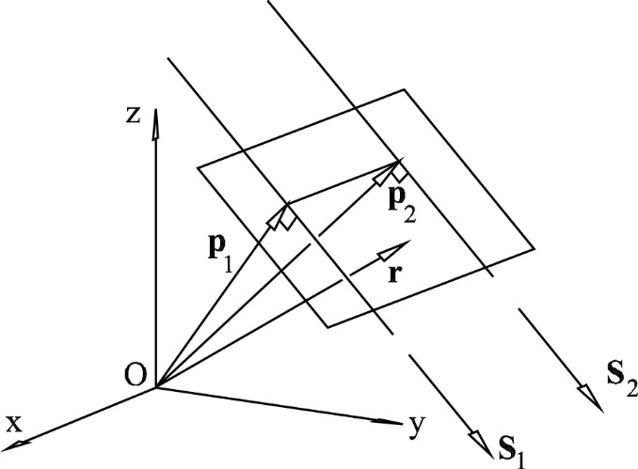
1.7.3 The plane defined by a pair of parallel lines.
Fig. 1.13. The Plane Through a Pair of Parallel Lines

Slide 64
1.7.3 The plane defined by a pair of parallel lines.
where S₁ is a unit vector
given: line defined by {S₁ ; S_{OL1}}
parallel line defined by {S₁ ; S_{OL2}}
find: coord. of plane [D_{O3} ; S₃]

Slide 65
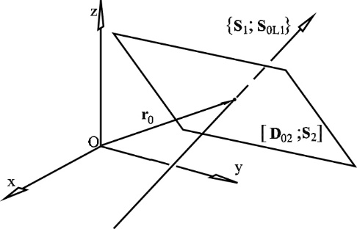
1.8 A line and a plane determine a point.
Figure 1.14: A Line and a Plane Determine a Point

Slide 66
1.8 A line and a plane determine a point.
given: line {S₁ ; S_{OL1}} ;
plane [D_{O2} ; S₂]
find: point of intersection, r_{O}

Slide 67
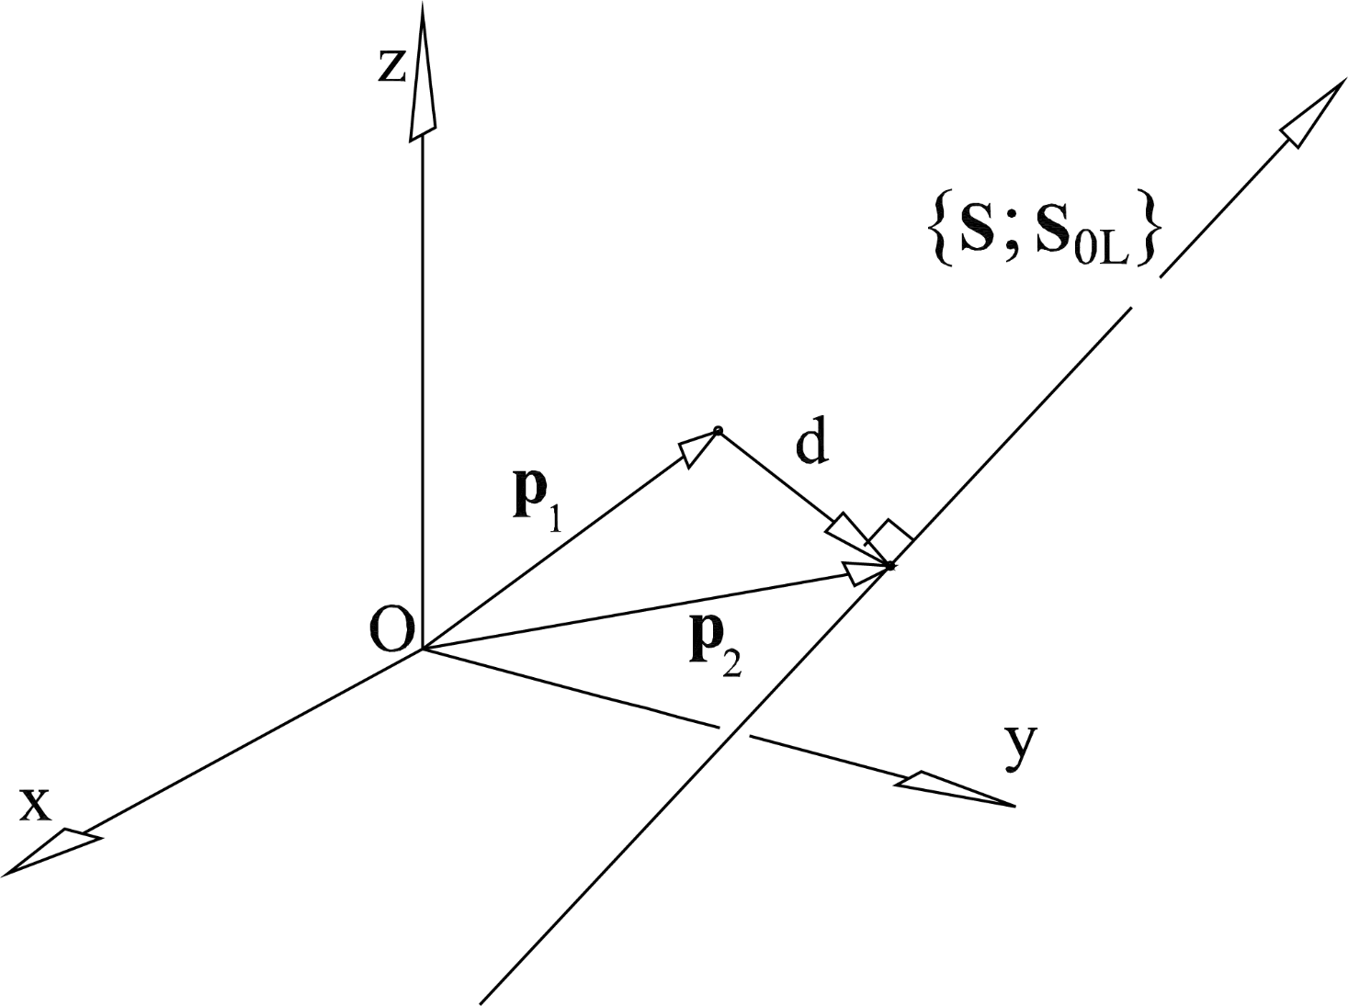
1.9 Find the point on a line that is closest to a given point.
d
Figure 1.15: Closest Point on a Line to a Given Point

Slide 68
1.9 Find the point on a line that is closest to a given point.
given: line {S ; S_{OL}} ;
point p₁
find: point on line closest to p₁, p₂
d

Slide 69
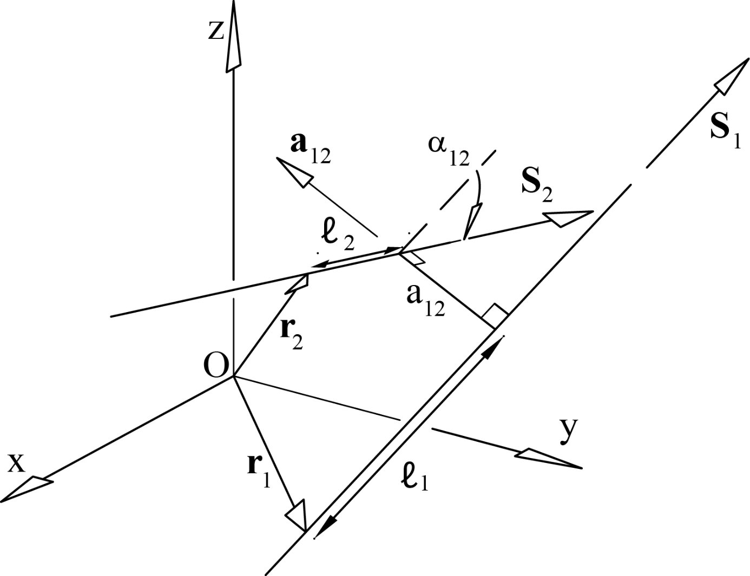
1.10 The mutual moment of two lines.
given: {S₁ ; S_{OL1}}, {S₂ ; S_{OL2}}
where S₁ and S₂ are unit vectors
Fig. 1.16: A Pair of Skew Lines

Slide 70
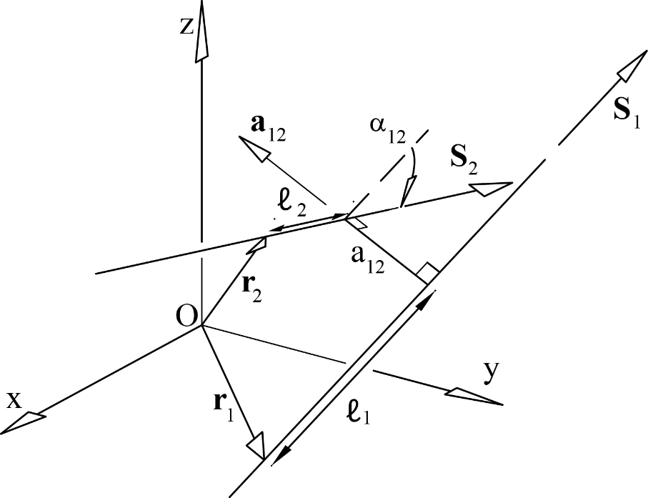
1.10 The mutual moment of two lines.

Slide 71
1.10.1 Numerical example:
given: {S₁ ; S_{OL1}} = {1, 2, 1 ; -2, 1, 0} dimensionless ; meters
{S₂ ; S_{OL2}} = {-3, 1, 0 ; 1, 3, 5}
find: for your choice of a₁₂ find α₁₂ and a₁₂

Slide 72

1.11 Determination of the Unique Perpendicular Line to Two Given Lines.
1.17 Definition of Points r_{E!} and r_{E2}

Slide 73

1.11 Determination of the Unique Perpendicular Line to Two Given Lines.
given: {S₁ ; S_{OL1}}, {S₂ ; S_{OL2}}
where S₁ and S₂ are unit vectors
(1.154)
(1.157)
Cross (1.157) with S_{OL1}

Slide 74
1.11 Determination of the Unique Perpendicular Line to Two Given Lines.
given: {S₁ ; S_{OL1}}, {S₂ ; S_{OL2}}
where S₁ and S₂ are unit vectors
since r_{E1} lies on the first line, r_{E1} ⋅ S_{OL1} = 0 and
The Plucker coordinates of the line that is mutually perpendicular to the two given lines are

Slide 75

Summary:
given:
{S₁ ; S_{OL1}}, {S₂ ; S_{OL2}} where S₁ and S₂ are unit vectors
select:
a direction for a₁₂
for example
find: α₁₂, a₁₂, r_{E1}, r_{E2}
(must handle special case if lines are parallel)
(must handle special cases if denom = 0)

Slide 76


given: {S₁ ; S_{OL1}}, {S₂ ; S_{OL2}} where |S₁| = |S₂| = 1, S₁⋅S_{OL2} + S₂⋅S_{OL1} = 0, and S₁ is not parallel to S₂
find: point of intersection, r₀
will show two solution approaches
1.17

Slide 77


Approach 1
The point r₀ must lie on both lines. Thus,
r₀ × S₁ = S_{OL1} (1.176)
r₀ × S₂ = S_{OL2} (1.177)
performing a cross product of (1.176) with S₂ gives
S₂ × (r₀ × S₁) = S₂ × S_{OL1}
(S₂ ⋅ S₁) r₀ – (r₀ ⋅ S₂) S₁ = S₂ × S_{OL1} (1.179)
performing a scalar product with S₁ gives
(r₀ ⋅ S₁)(S₂ ⋅ S₁) – (S₁ ⋅ S₁)(r₀ ⋅ S₂) = S₁ ⋅ (S₂ × S_{OL1}) (1.180)
substituting (S₁ ⋅ S₁) = 1 and multiplying by -1 gives
r₀ ⋅ [S₂ – (S₂ ⋅ S₁) S₁] = (S₁ × S_{OL1}) ⋅ S₂ (1.181)
Now we can solve (1.155) and (1.160) for r₀.
- form cross product of (1.155) with [S₂ – (S₂ ⋅ S₁) S₁] . expand, and solve for r₀
(1.185)

Slide 78

given: Plucker coordinates of 2 non-parallel intersecting lines
{3, 2, 4 ; 8, 0, -6} {dimensionless ; meters}
{-1, 3, 2 ; 4, 0, 2}
note that the mutual moment of the 2 lines is zero
find: point of intersection

Slide 79

Approach 2
The point r₀ must lie on both lines. Thus,
r₀ × S₁ = S_{OL1} (1.176)
r₀ × S₂ = S_{OL2} (1.177)
performing a cross product gives
(r₀ × S₁) × (r₀ × S₂) = S_{OL1} × S_{OL2} (1.186)
expanding this expression gives
[(r₀ × S₁) ⋅ S₂] r₀ – [(r₀ × S₁) ⋅ r₀] S₂ = S_{OL1} × S_{OL2} (1.187)
substitute [(r₀ × S₁) ⋅ r₀] = 0 and (r₀ × S₁) = S_{OL1} to get
(1.188)

Slide 80
Comparison of Approaches
Equation (1.188) will yield 0/0 if
the first line passes through the origin
the two lines lie in a plane that passes through the origin (because S_{OL1} will be perpendicular to the plane and S₂ is in the plane ; also S_{OL1} and S_{OL2} will be parallel)
(1.188)
(1.185)

